Slide 1
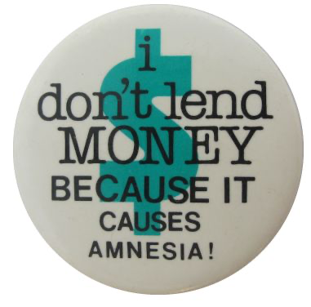
This presentation is an insights journey I drew from Loan Dataset that was shared for EDA.

Slide 2
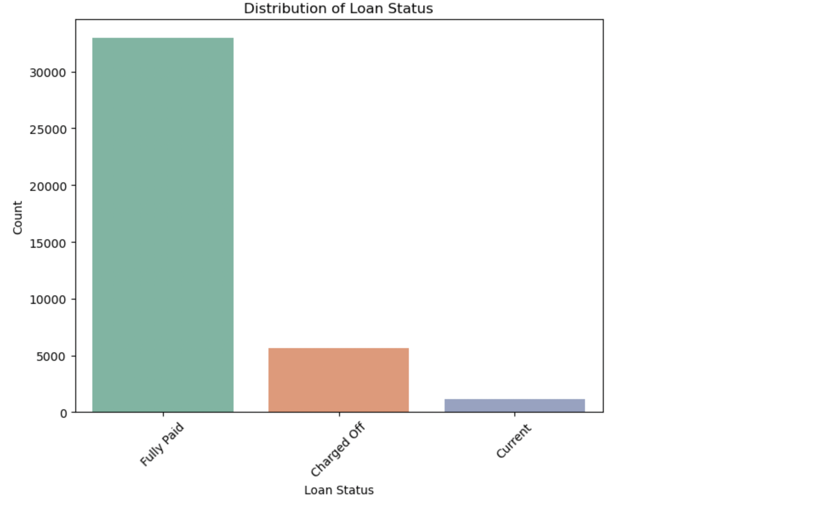
So, He says that near about 5000 or less people cheated with us…

Slide 3
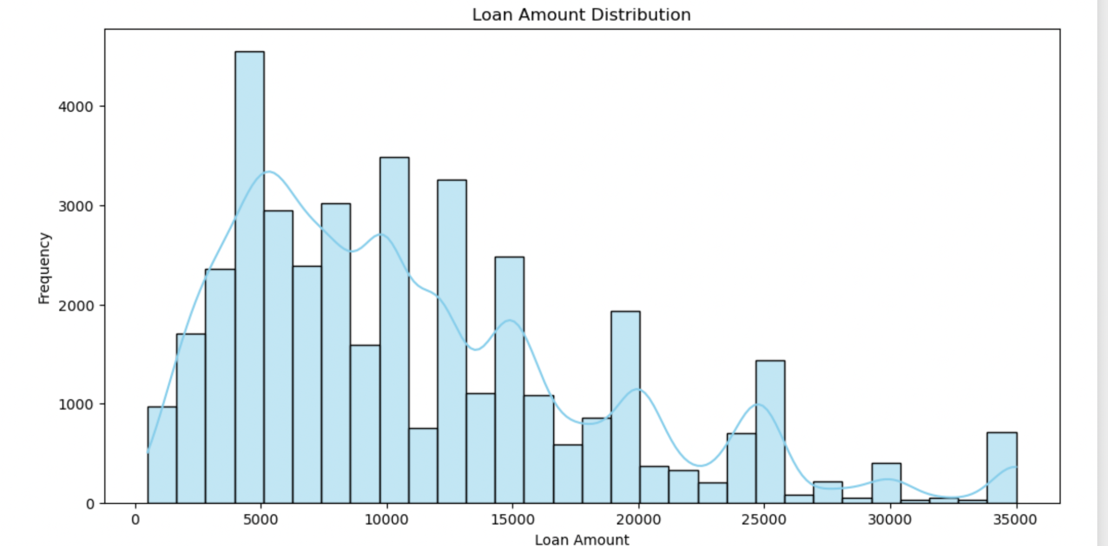
This much people borrow and look at the patterns…. Man!

Slide 4
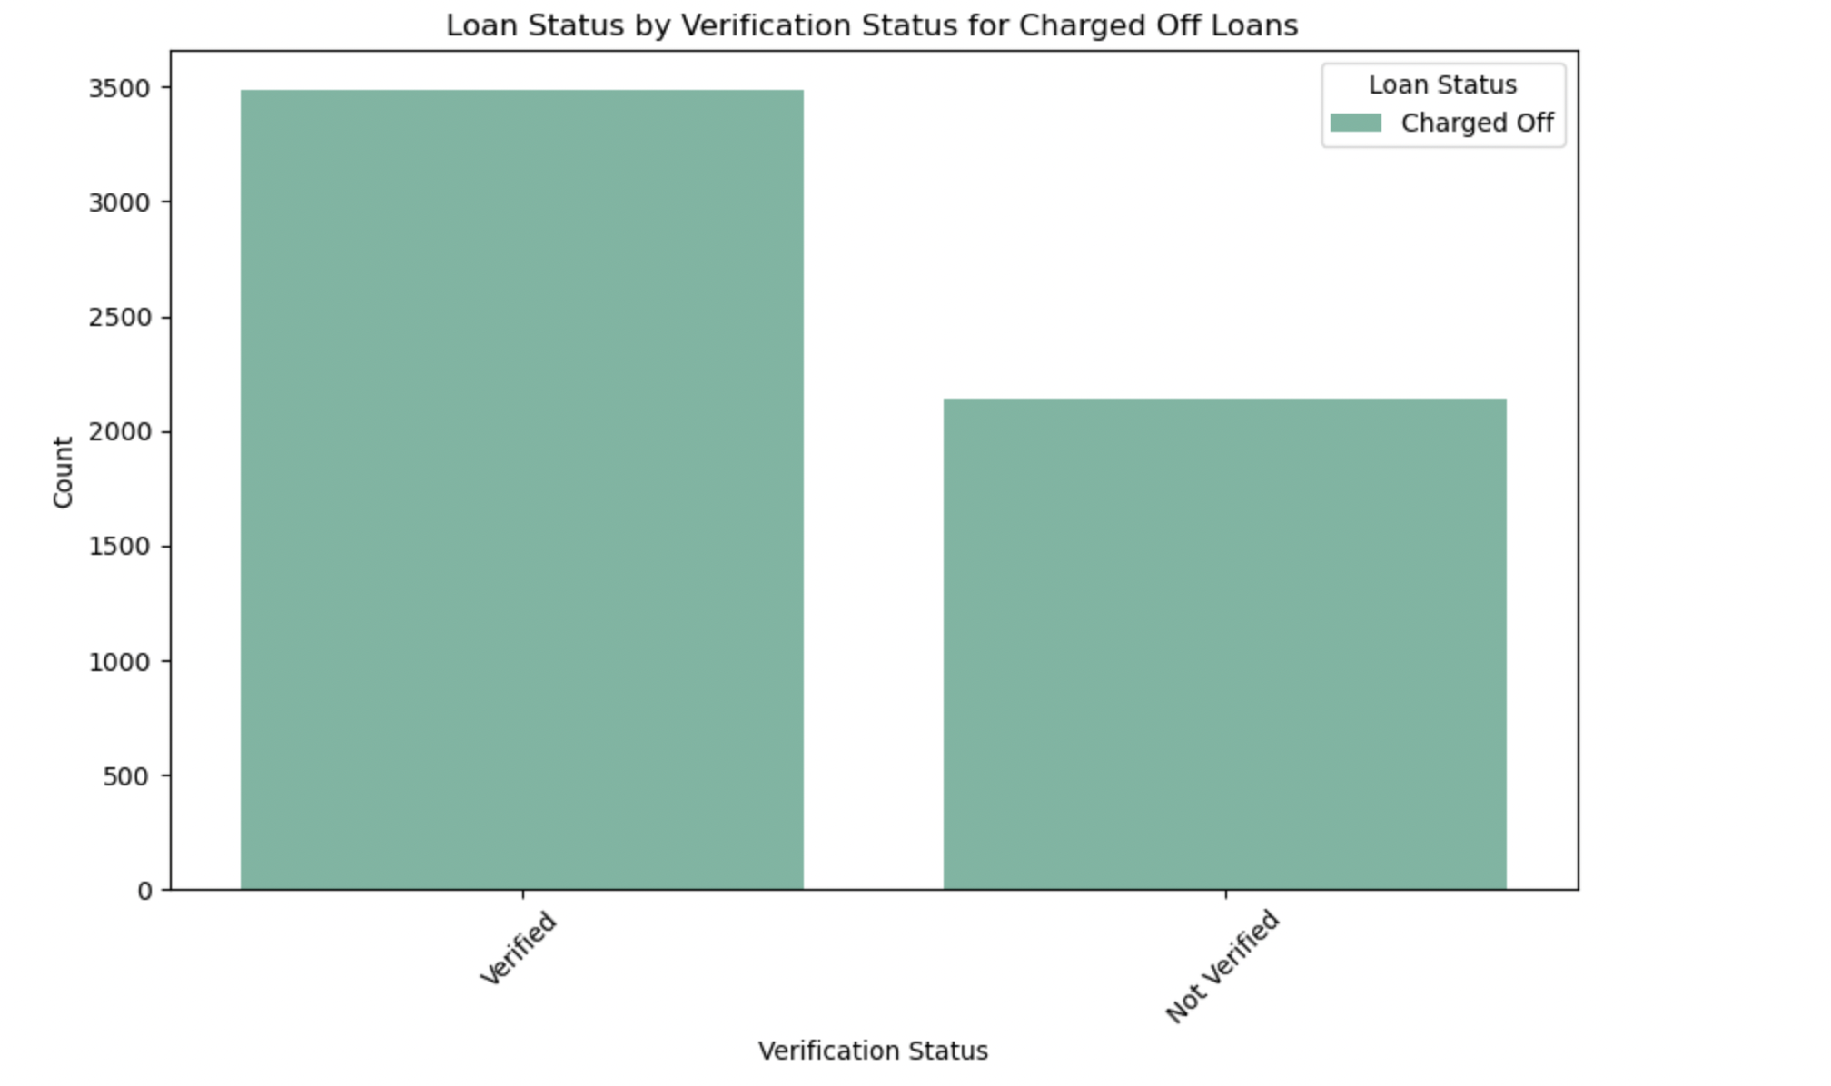
Well, Stop verification!!
Verified ones cheat more than the latter..

Slide 5
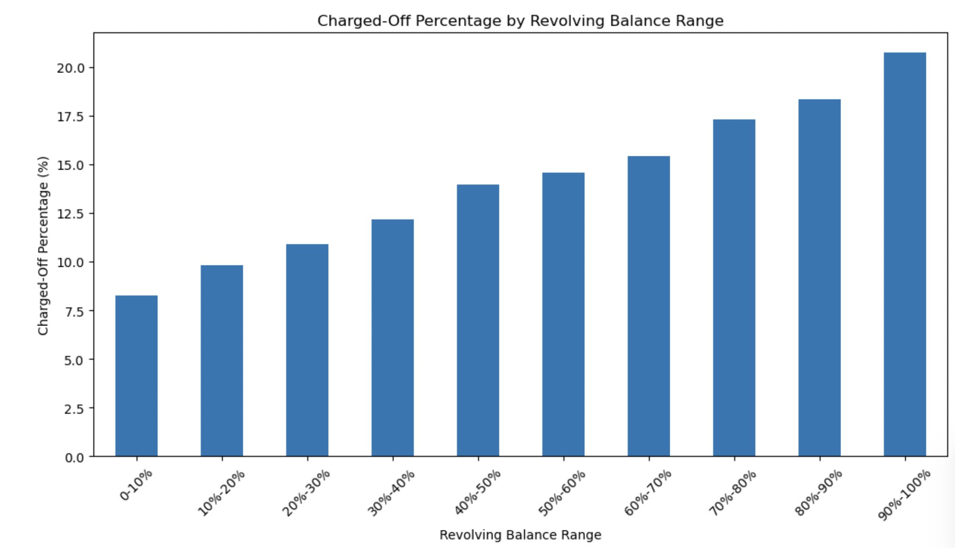
This is what you should check first!!, How much is % is already occupied, There seems to be 1:1 correlation(approx)

Slide 6
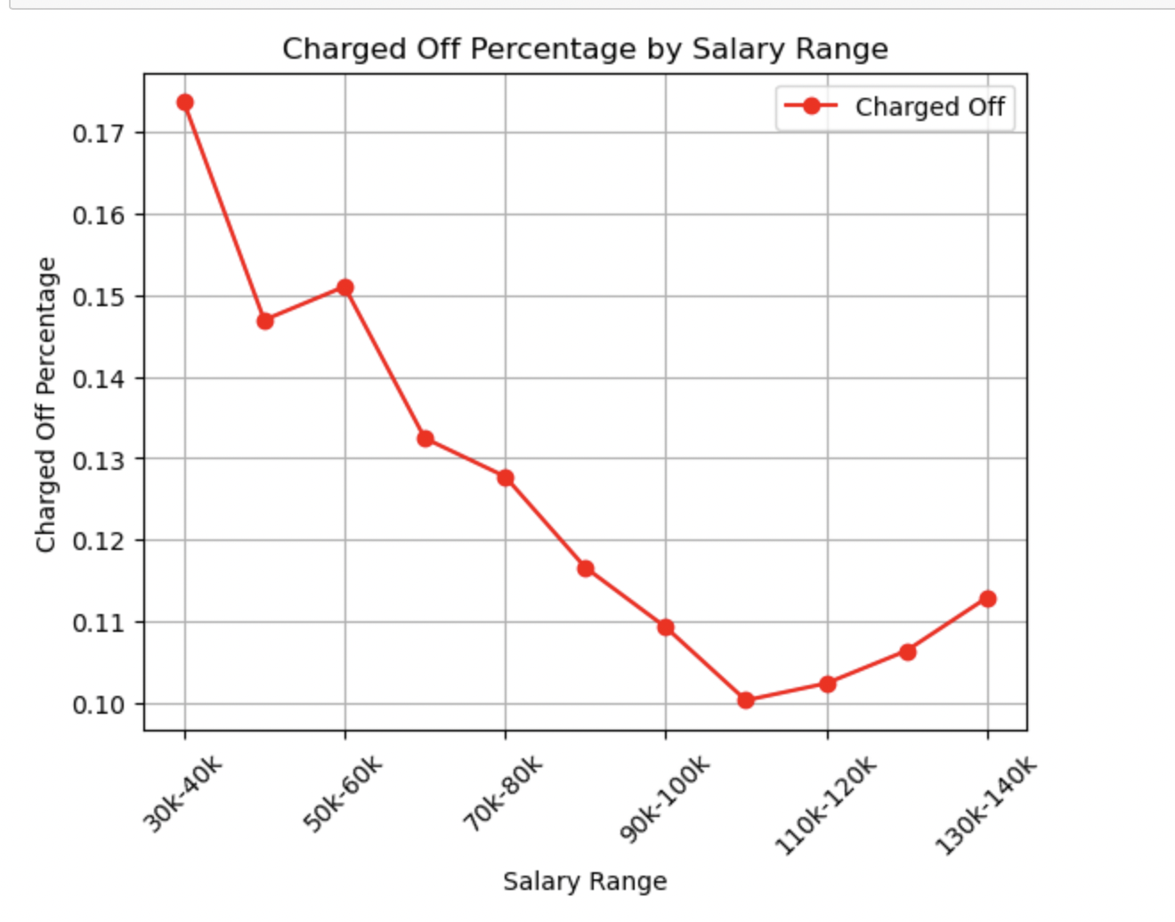
Okay, So you are saying if they earn good they will pay back…..Right boss.

Slide 7
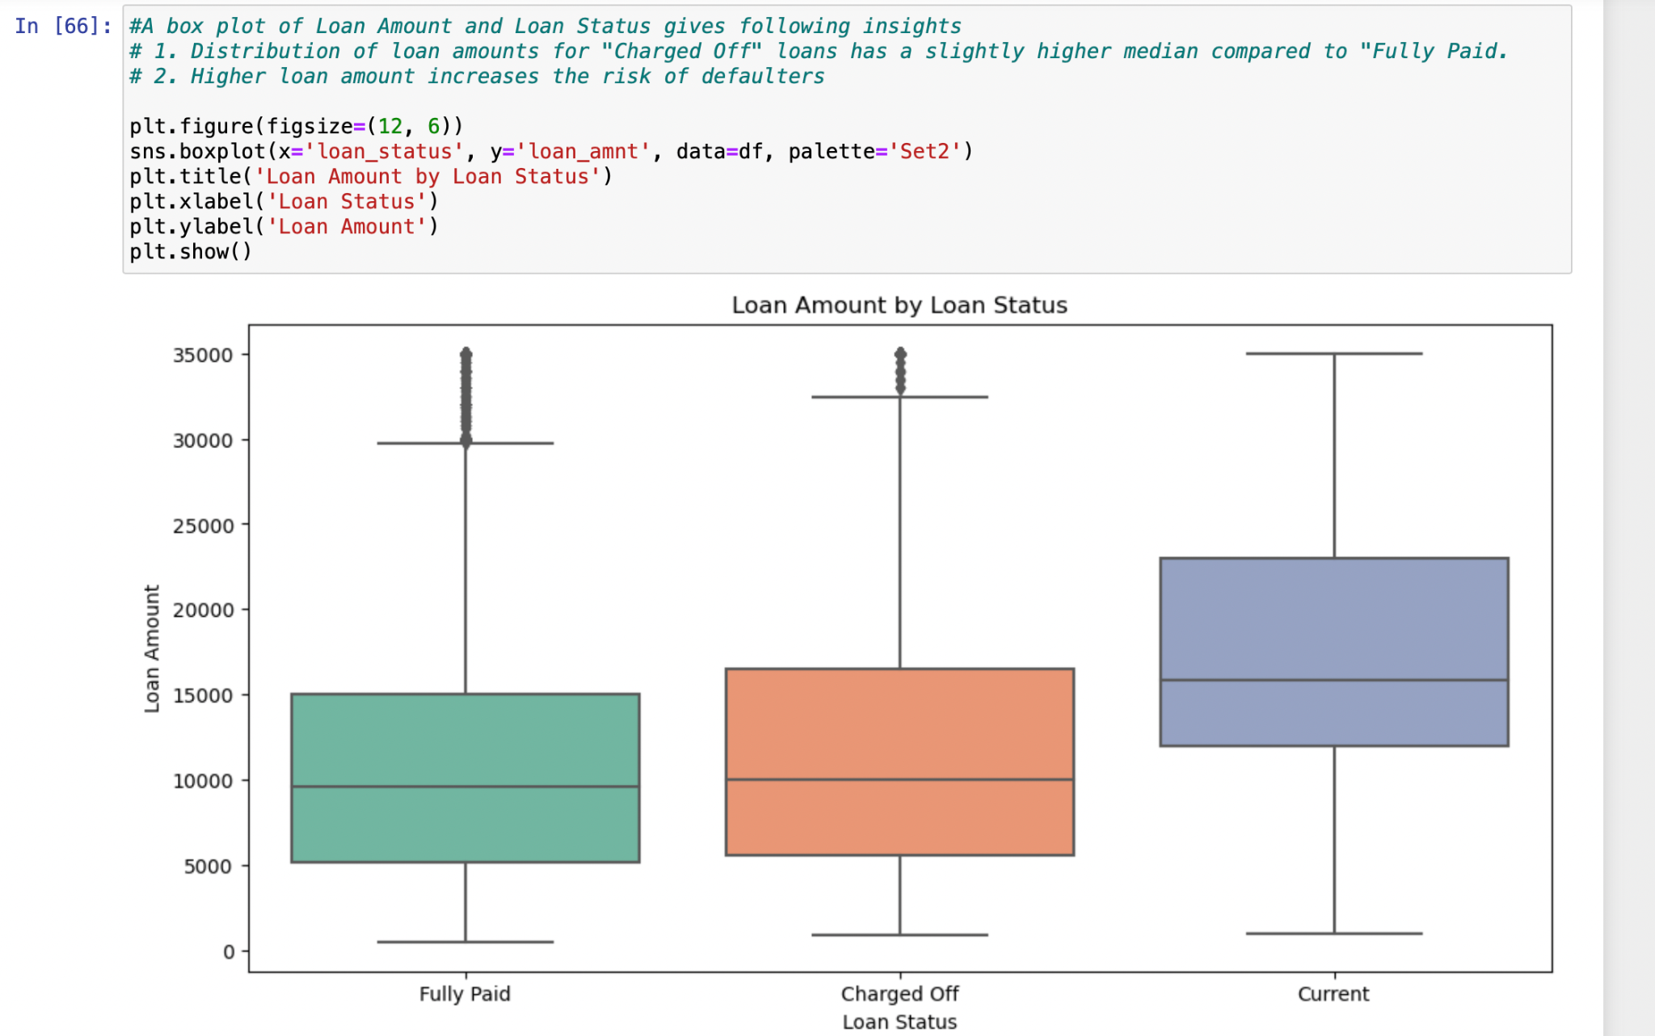
Let's be serious!

Slide 8
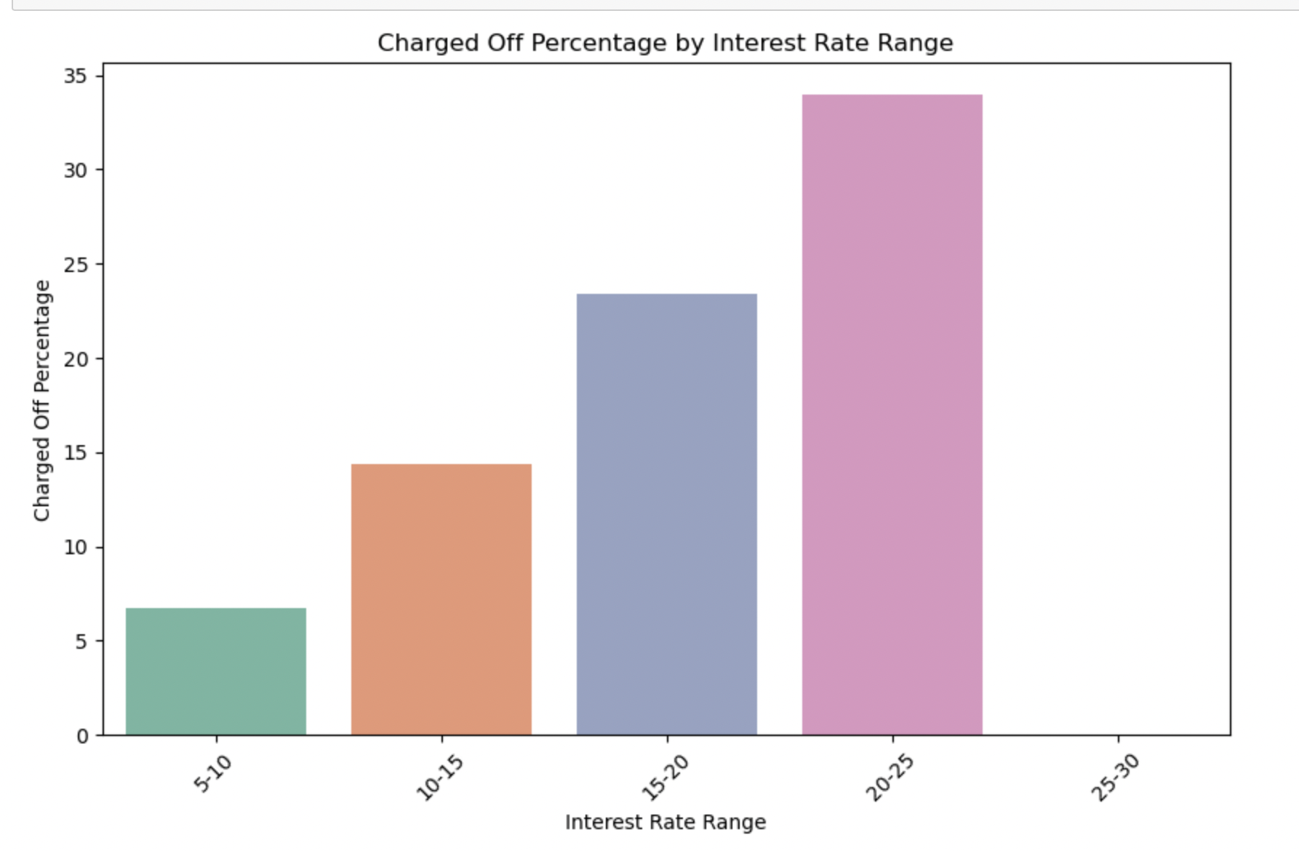
Isn’t it obvious that!! This is a 1:1 progression.

Slide 9
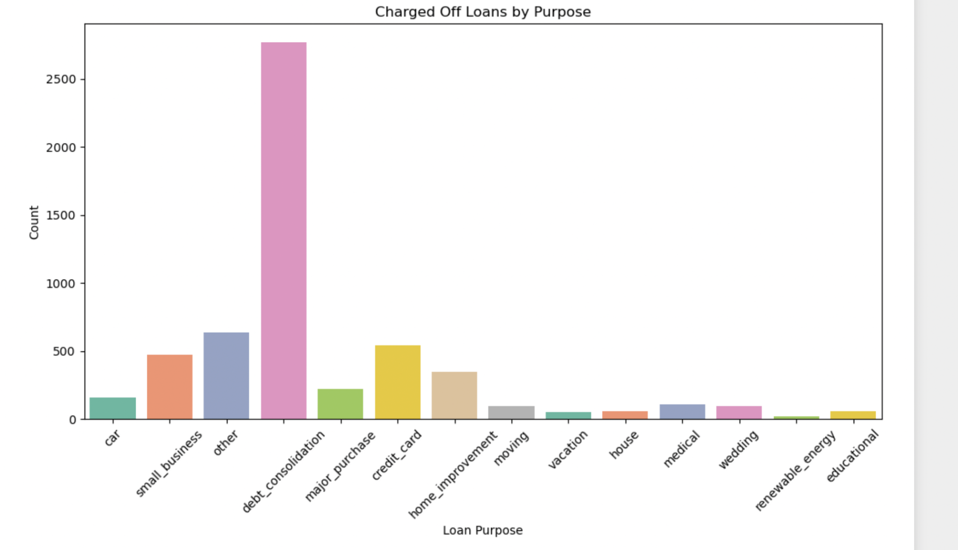
Hey, Hang on
We can trust anything but debt_consolidation!!!!

Slide 10
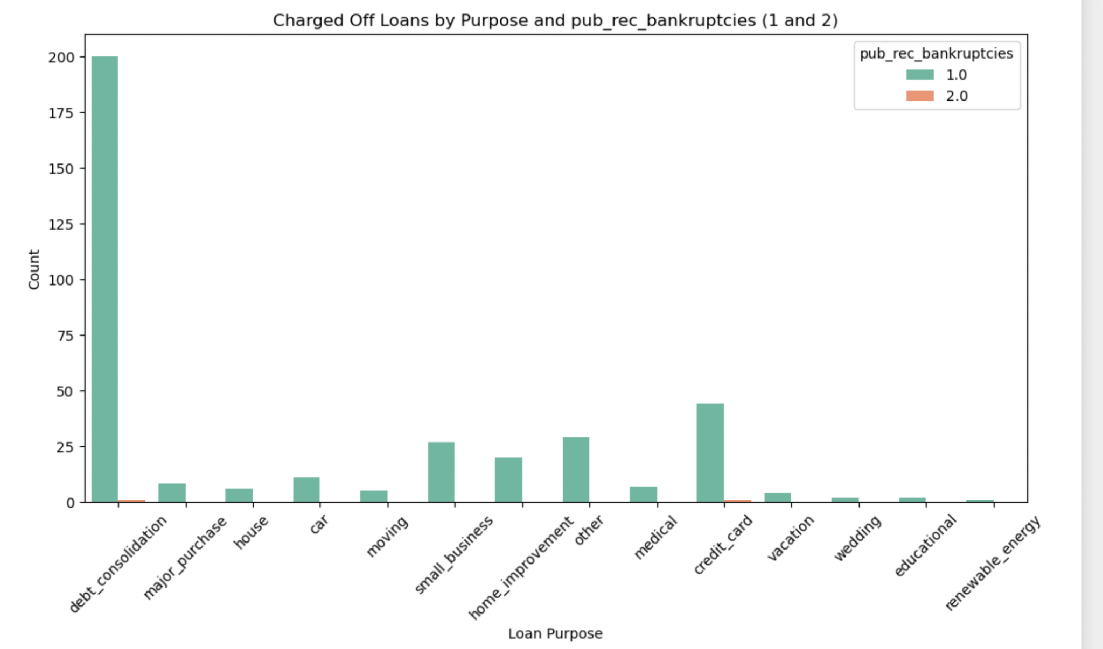
Told ya!!! Already.

Slide 11
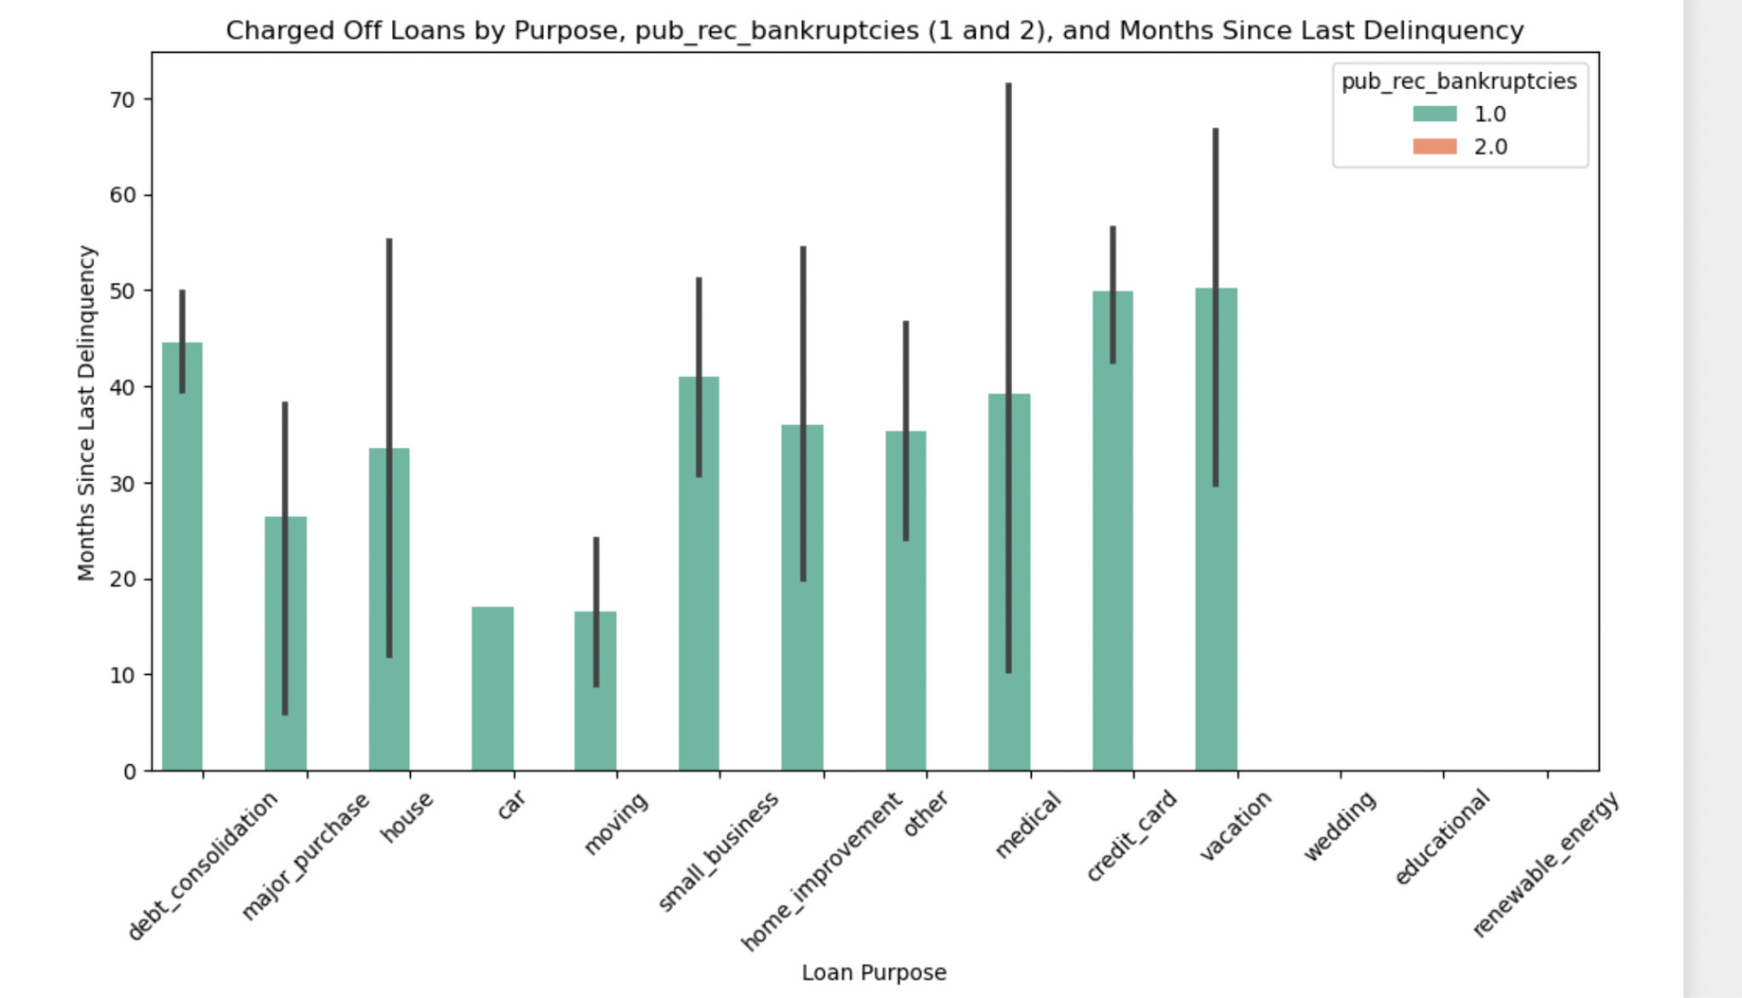
Medical has most range & look at the cars man!

Slide 12
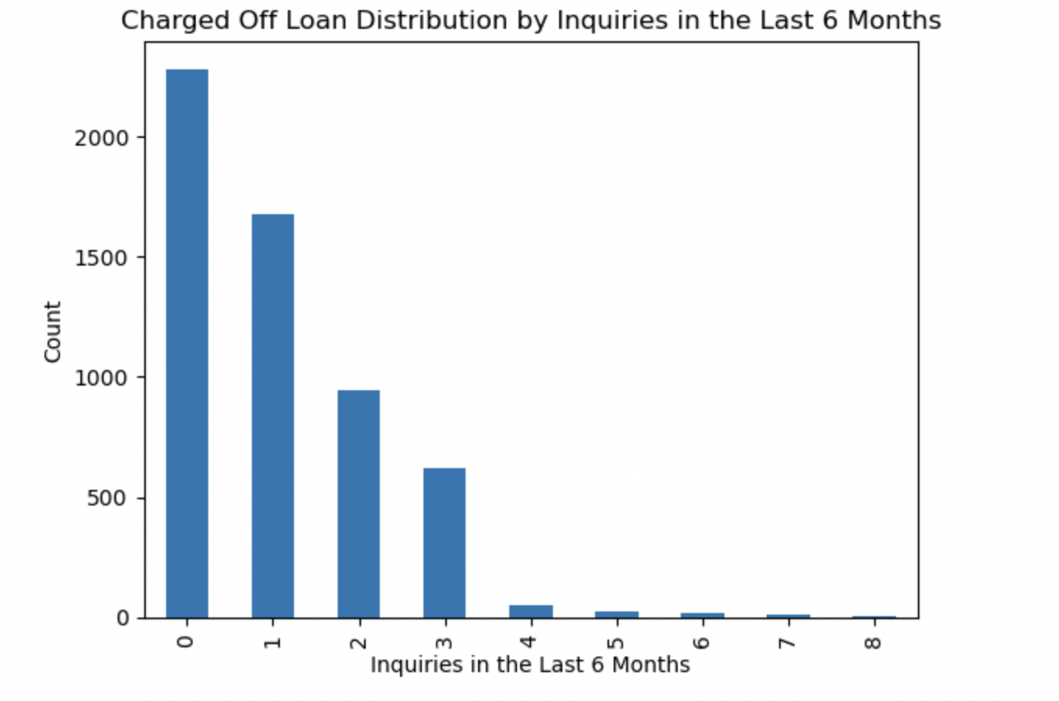
Being in touch reduces chances of cheat!!

Slide 13
So be in touch,
Hi there, You just watched the insights I had to share from loan dataset.
Excuse me if I made it sound like a story!

